Slide 1
Unlocking the mysteries of Web Technology
An introductory workshop on the basic components of a webpage

Slide 2
3 Things:
The repository is here: http://bit.ly/2mRzSc3
W3 Schools – a great resource for HTML/CSS and a little JS
MDN (Mozilla Developer Network) – Best ECMAScript/JavaScript reference out there

Slide 3
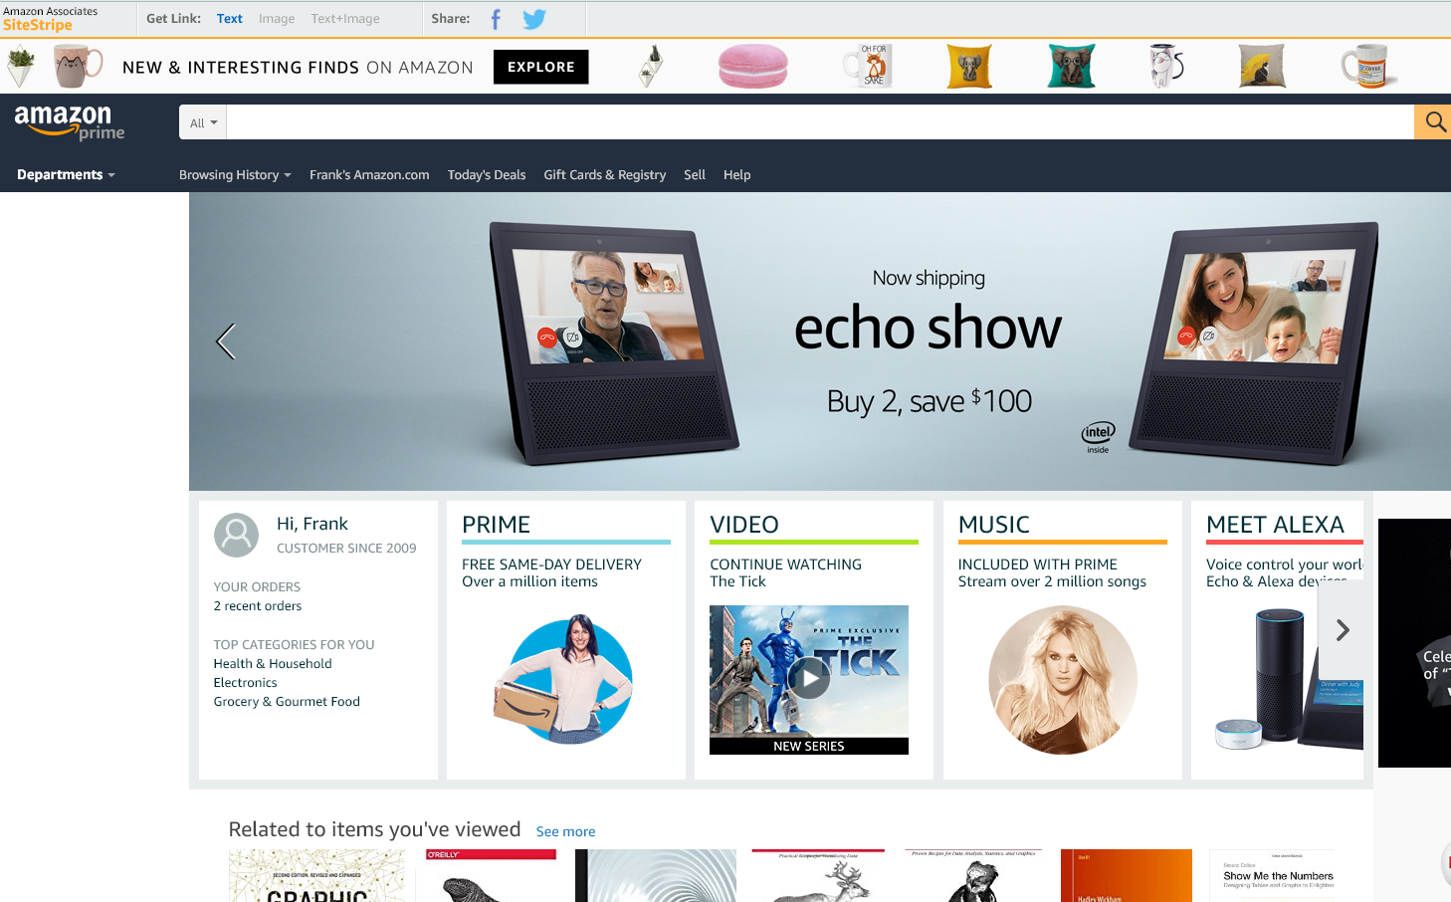
What the heck is web technology?
Notes:
For example, how does a website like amazon exist? Amazon’s website is amazing, [buy] the way. Truly though, there are a lot of moving parts here, a lot of personalization based on data you have helped amazon create. The visual design of amazon is brilliantly designed to maximize your ease of making purchases that you want.
We won’t be deconstructing amazon here or certainly not attempting to replicate it. But this workshop will hopefully give you a sense about how the technologies here help put something like amazon together.

Slide 4
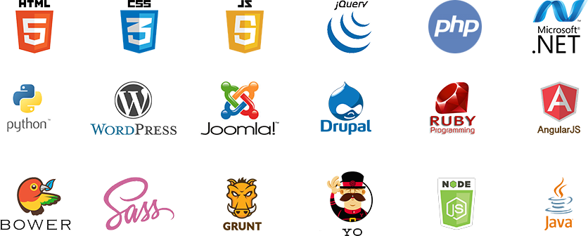

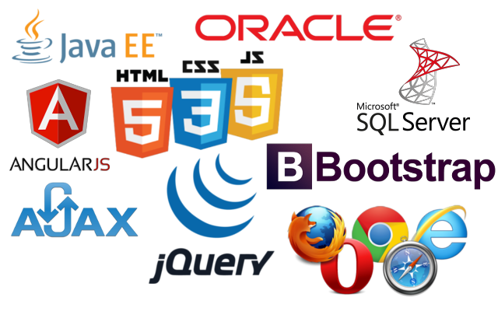
Notes:
Just a quick google search for “web technologies” can show you a lot about how complex web development is. All of these icons represent some sort of technology solution to some kind of problem that web developers face. Some of these might look familiar to you, others are perhaps too specific or proprietary.

Slide 5
The frontend to the website you see
The backend logic and web services
Server logic and data retrieval
The physical infrastructure
Notes:
There are four basic “layers” to what I will be calling the “web technology stack” (and arguably more if you consider user research and design its own layer).
Each layer in the stack has its own technologies and considerations. Each layer gains more and more solutions, libraries, modules, languages, and packages every year. It’s crazy to imagine where the web will be in a few years from now.
Each layer is it’s own universe of complexity. I tend to develop mostly in the frontend and a little on backend and db services.
So, how do I make this workshop relevant to someone who will want to do something using web technology and not have to relearn things every time they want to visualize data, web scrape, or just edit their portfolio or CV website?

Slide 6
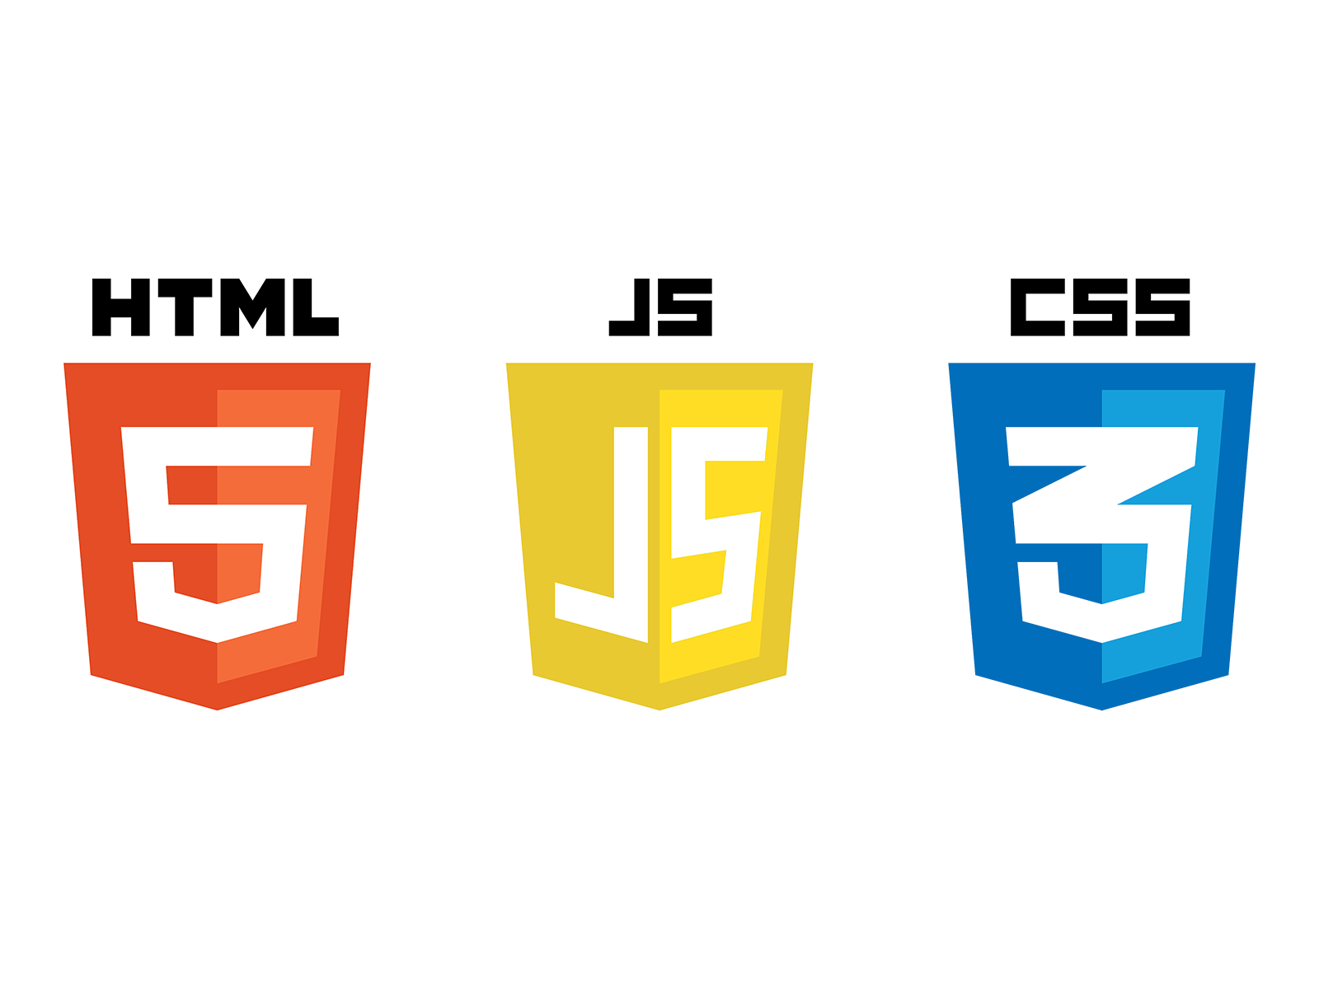
Notes:
We will hit the basics here. There is a lot to unpack, really. But we will start with these three technologies. In 5 years, these may change a little but the basics will most likely be the same.
We have HTML 5, Javascript, and CSS 3
HTML has been around since the beginning and CSS isn’t going anywhere either.
JavaScript has become a respectably robust and formidable development language in the past decade especially.
These technologies evolved out of a need for a ubiquitous and portable experience across the internet
One of the early problems that the web faced was a multitude of environments that any person might be on when they accessed the internet.

Slide 7
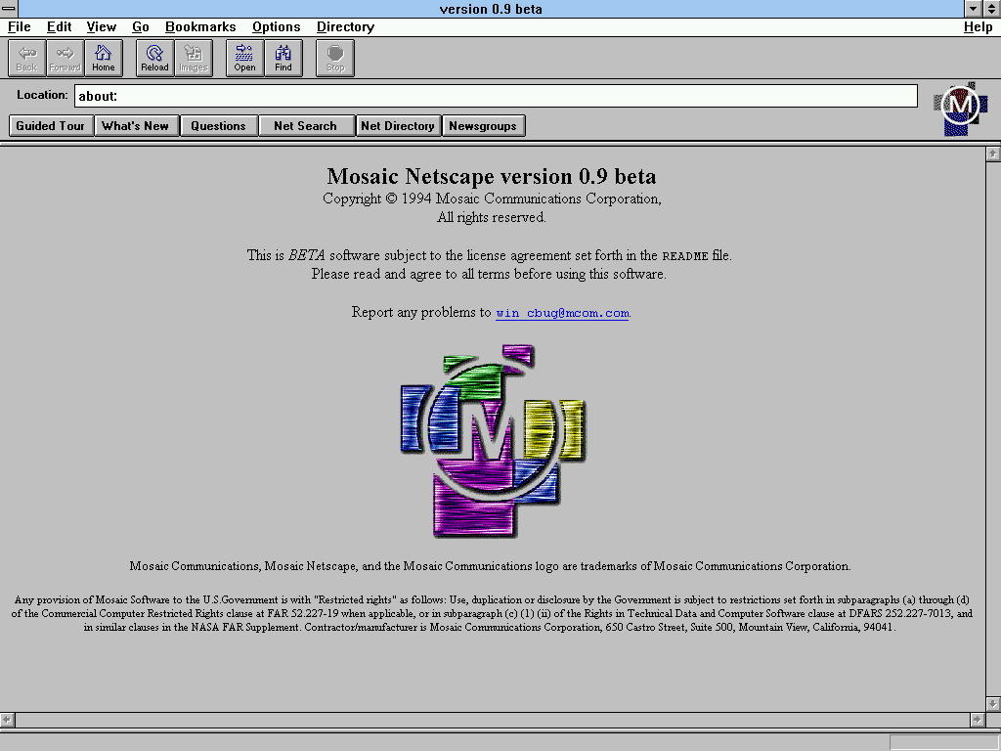
Notes:
A brief bit of history here:
Mosaic was the first browser to believe in the possibility of a uniform web experience between mac and windows users.
Mosaic also implemented HTML 2.0
HTML’s initial kinks and awkwardness were beginning to iron out, and the web was ready to reach a broader audience
Of course, Mosaic evolved into Netscape Navigator, and long story short: a multitude of web browsers were born

Slide 8








Notes:
Browsers interpret HTML, CSS, and JavaScript
Browsers simply read the markup and display whatever the HTML and CSS says to
Despite this, uniformity across browsers is still to this day a problem (although thankfully at least Explorer is now dying)

Slide 9
Walkthrough
Notes:
[Set up dual screen: development environment is shown and these bullet points are meant to be read by the presenter on their own screen]
Now that I’ve talked a lot, I’ll show you how you can create a web page so that you can see the components involved in their most basic form.

Slide 10
HTML Basics
Using a text editor to create a file that the browser can read
Inspecting the element in the browser, explaining elements
Recreating the file, this time with actual markup!
Inspecting the element again, showing how it is the same
Explaining what HTML stands for and what its purpose is
Showing what a basic HTML file could look like

Slide 11
CSS Basics
Manipulating the style of an element directly
Discussing why styling is best when applied broadly
Manipulating the style of an element with in-html css
Manipulating the style of an element with a css file
Discussion about why all of these options exist
Showing a hover element
Explaining what CSS stands for and what its purpose is

Slide 12
CSS Basics 2.0
All in one file: explain each element, one at a time
Showing how the cascading works: parent is styled one way and the child is also styled
Showing how child with different styling will not inherit
Showing how an in-line styling overrides the css
Showing how an ID element overrides the css

Slide 13
Challenge #1
Build a 250x250 pixel element with a 150x150 pixel element inside
Tip: Try using a “div” element <div>, give them borders so we can see
Style these using a CSS document, not inline HTML
Use classes, not IDs to accomplish this
Make the 250 pixel element change color on hover and the 150 pixel element change grow larger on hover
Bonus:
Make the element’s maximum size 250, but it will shrink in size if the browser shrinks in size (this is called responsive design)
Make the inner element’s size a % of the outer element

Slide 14
Scraping Basics
Showing how easy it is to “extract” html data
Showing how easy it is to “extract” css data
Show how to manipulate css or html directly through the DOM

Slide 15
Explain the DOM and Console: your best friends
Show the inspection properties for an element and talk about what that means
Show where the console is
Type a few things into the console

Slide 16
JavaScript Basics
JS documentation is deep and varied, and different browser companies will document their own usage
The best for web standards is Mozilla’s documentation at MDN (they show references to ECMAScript)
Javascript is used in Node, electron, adobe acrobat, and Apache’s CouchDB (not just web pages!)
JSFiddle (or JSBin) are the best for live-testing js in small functions or snippets

Slide 17
JavaScript 2.0
Write to the “document” using JS & the console
Inspect the element in HTML/CSS
Access the element using JavaScript
View the properties of the element in the console
Edit the innerhtml of the element
Create a new element using JavaScript
Assign a class to the new element
Adjust the style using JavaScript, show it as inline

Slide 18
Challenge #2
Go to google.com
Change the background color to “lemonchiffon”
Change the header image to this image:
http://bit.ly/2rdwZYJ

Slide 19
Javascript basics 3.0
Show basic buttons and looping and the differences of html-triggered JS, event binding, and event listening
Show event triggers passing as parameters
Explain how Javascript passes some parameters explicitly (you just have to learn what these are
Show the problem with triggering events on parent elements
Build a basic form with a text input and submit button

Slide 20
Challenge #3
Go to google.com
Add a button called “Dog Search” to the page that automatically puts “dog” in the search input and submits

